Slide 1

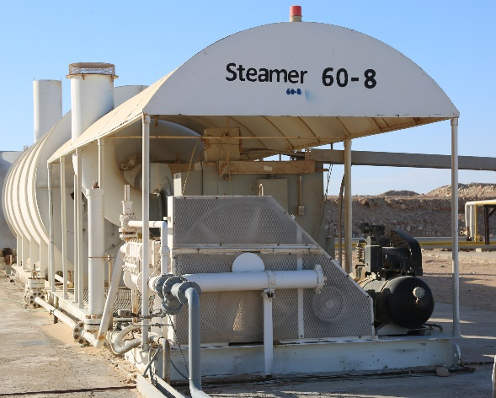
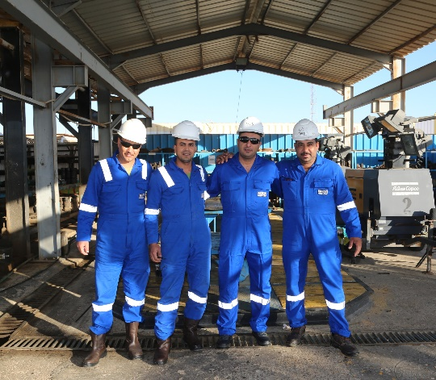
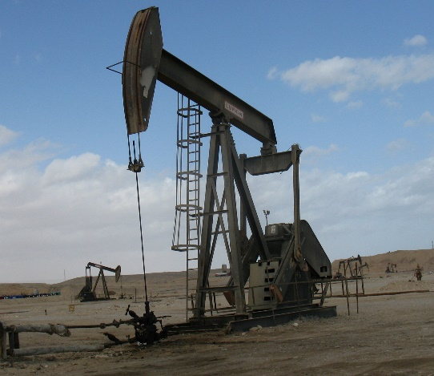
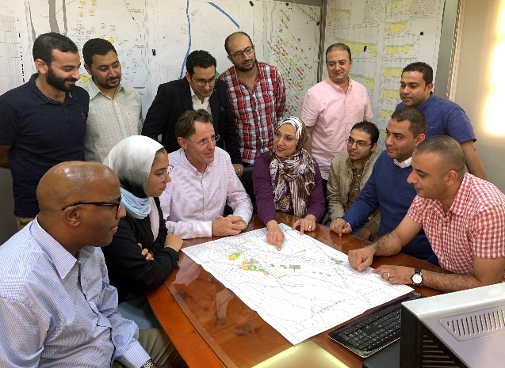
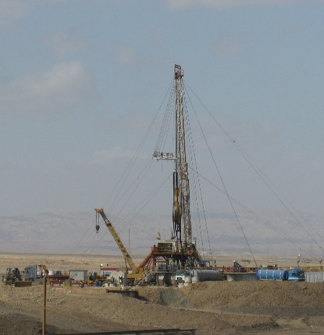
Applying geological understanding to well and reservoir management in complex carbonate reservoir

Slide 2
Agenda
Introduction.
Stratigraphic Overview.
Depositional Environment.
Reservoir Characterization.
  Heterogeneity.
  Dolomitization.
  Fracturing.
  Diagenesis and mineralization.
Paragenesis

Slide 3
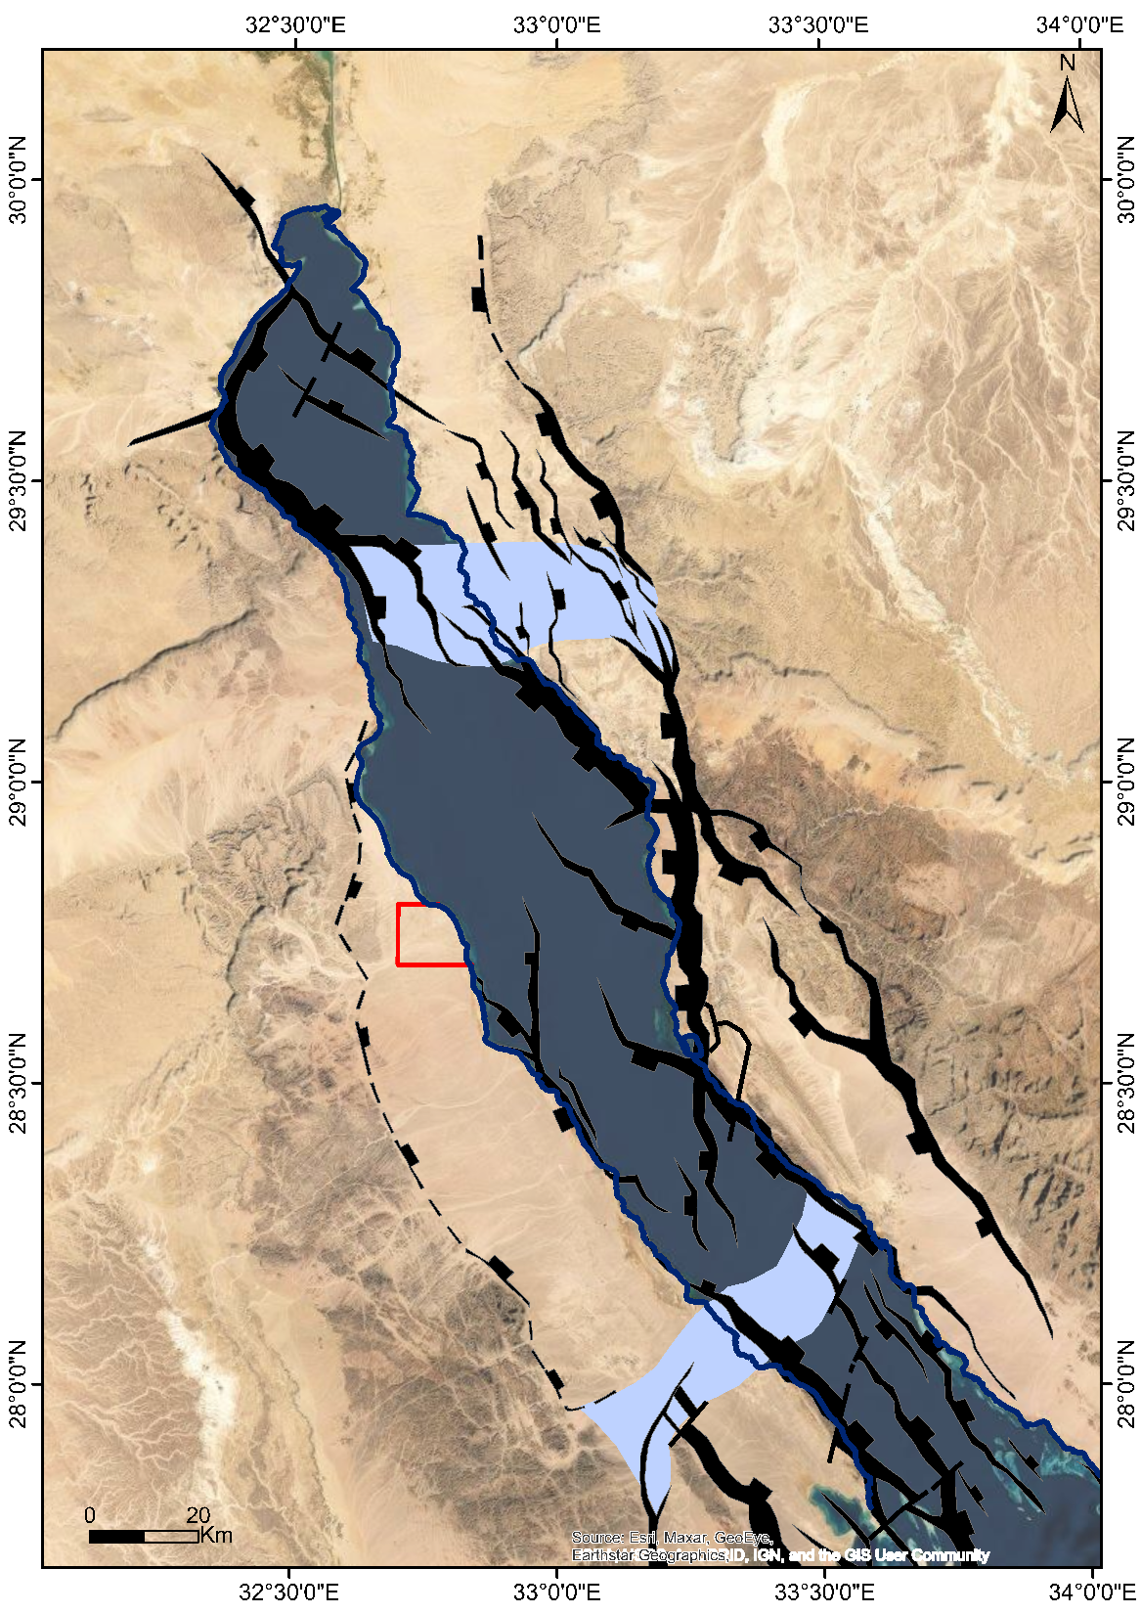
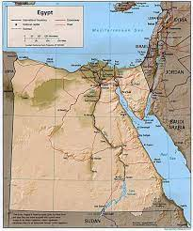
Location Map Of Issaran Field
Gulf
Gulf Of Suez
of
Galala-
Abu Zenima
AZ
Suez
Concession Boundary
El Galala El Qibliya
Project Area
Oil fields
Legend:
AZ
Accommodation Zone
Issaran located in the central part of GOS, 140 Km south of Suez City along the western coast.
Extensional Faults
Transfer Faults
Strike Slip Faults
Strata Dip Direction
Morgan AZ

Slide 4
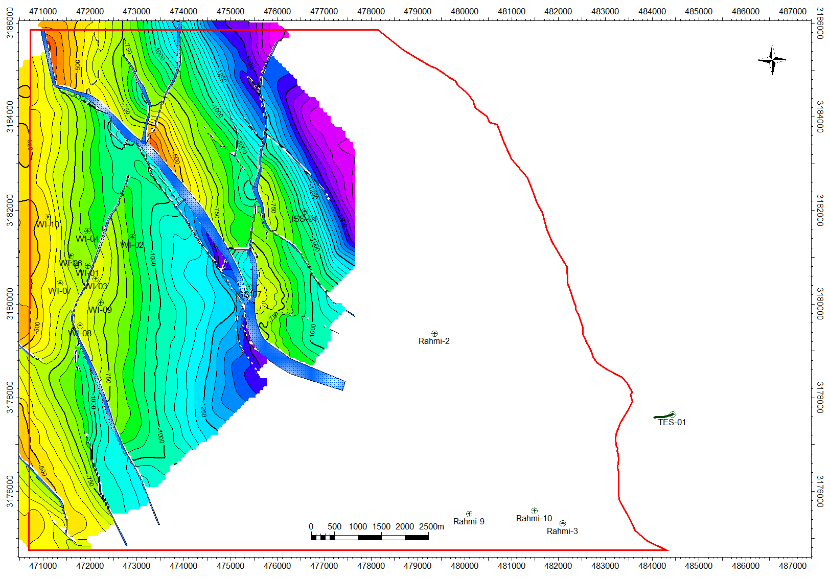
Issaran Stratigraphic Column in reference to GOS
ISS is split by fault blocks at all levels.
ISS concession has 5 oil bearing reservoirs; ZS, UD, LD, GH & NUK

Slide 5
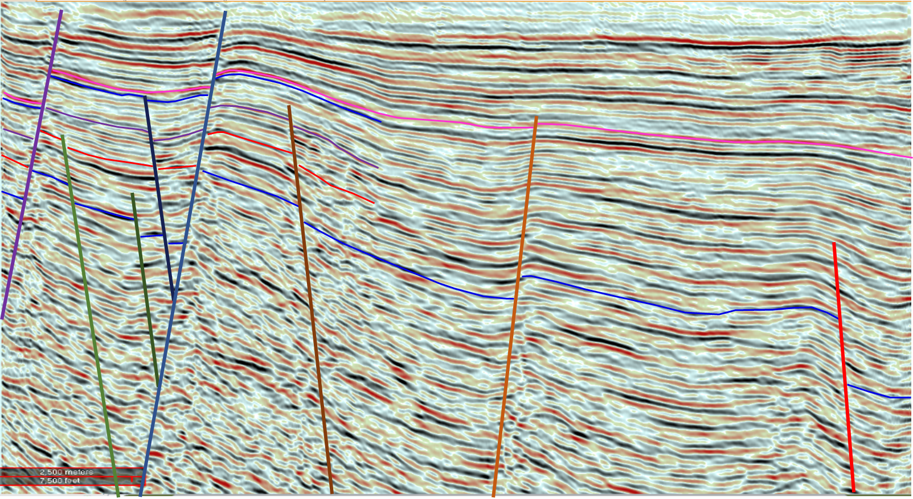
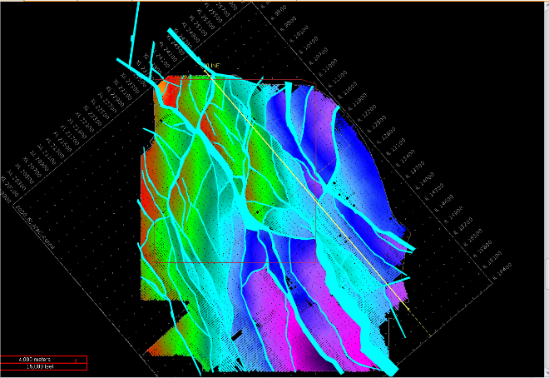
Cross Section
NW
SE
South Gharib
Upper Dolomite
Lower Dolomite
Gharandal
Eocene
Issaran field consists of two fault trends, The Major faults trending NW-SE (Clysmic) and Minor faults trending NE-SW (North oblique).
Strata dipping NE with average inclination 7-12°.

Slide 6
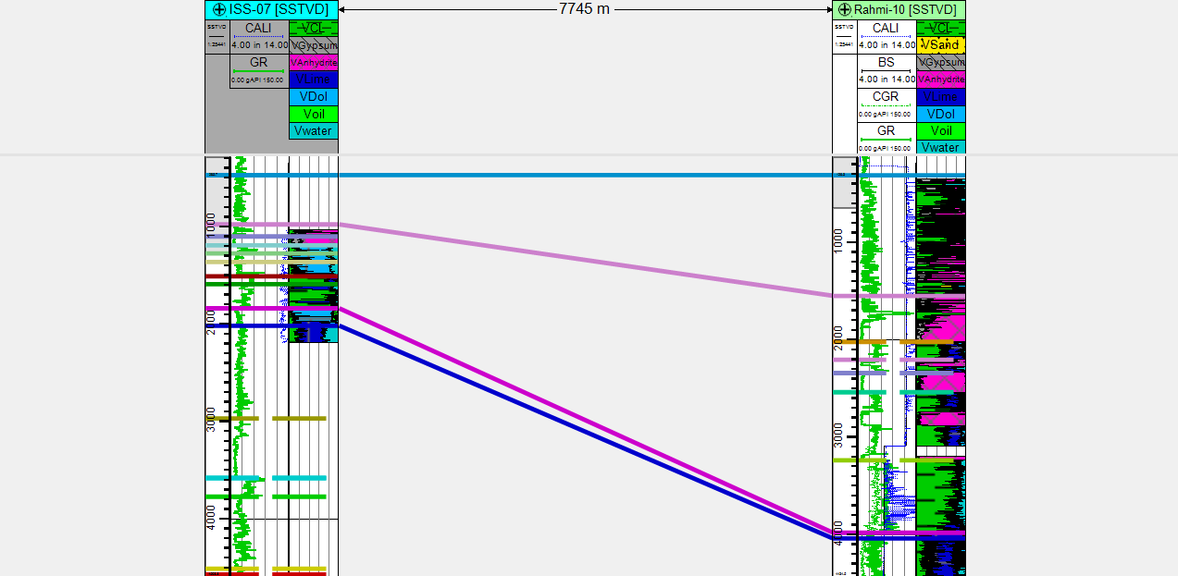
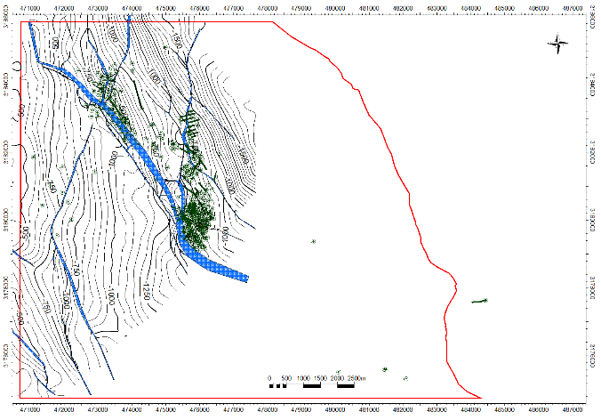
Stratigraphic column of Miocene from Issaran to Rahmi
Zeit
South Gharib
Nukhul
Eocene

Slide 7
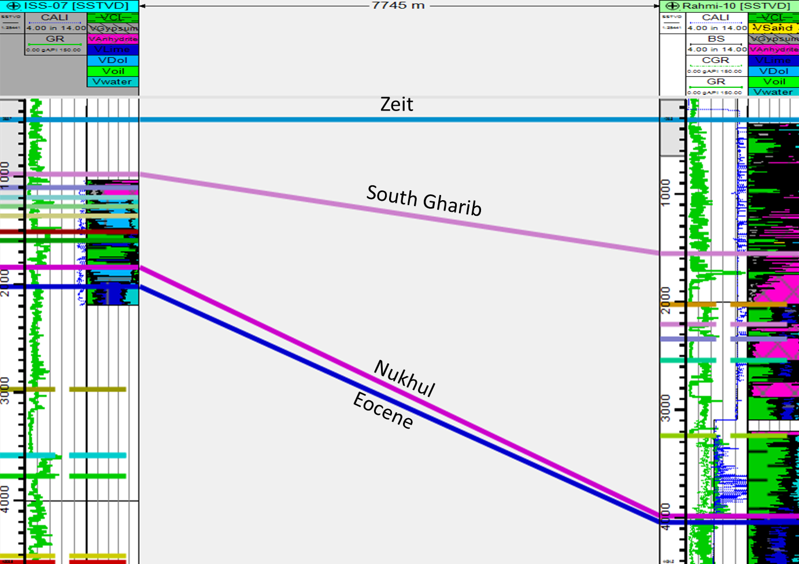
Stratigraphic column of Miocene
S.Gharib
ISS
Rahmi
UD
A
Belayium
H.Feraun
B
C
D
Feiran
Sidri
Intra Dol.
Baba
LD
A
B
Kareem
Shagar
C
Marka
D
GH
Sh.
L1
Rudies
LB1
L2
LB2
L3
LB3
L4
LB4
Nukhul

Slide 8
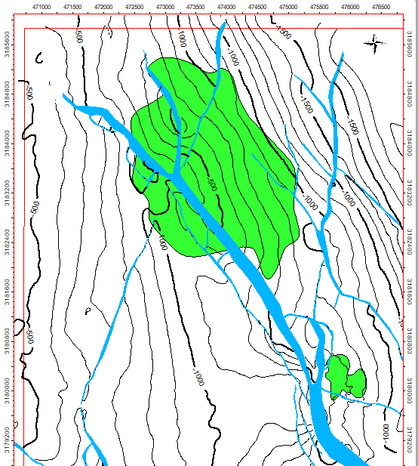
Facies Distribution of (UDA)

Slide 9
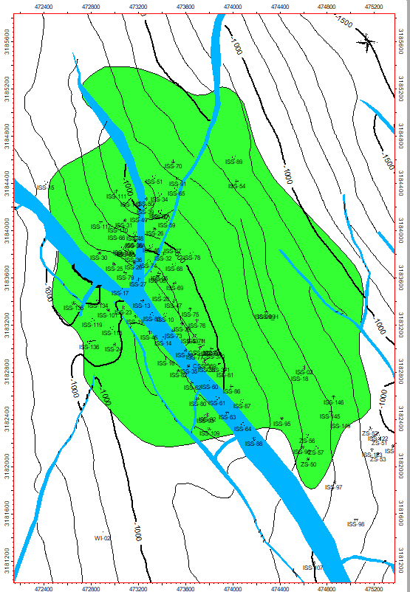
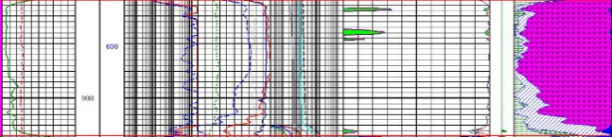
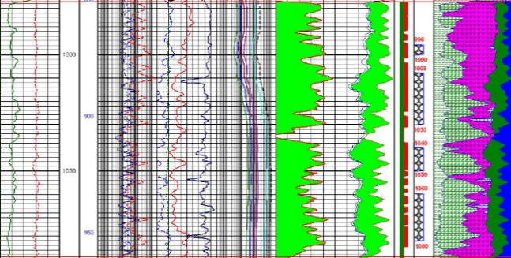
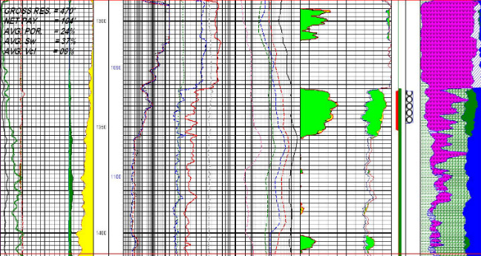
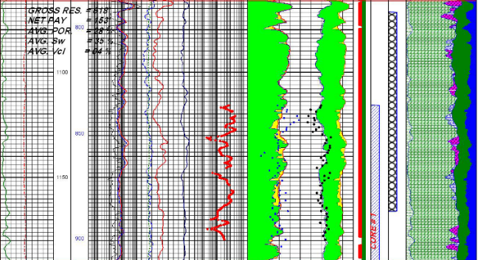
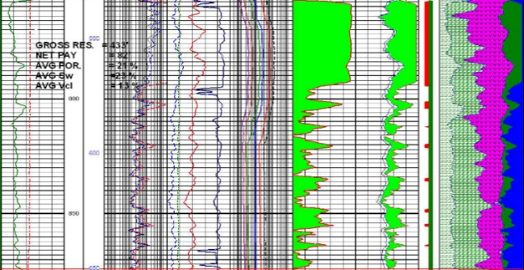
Facies Distribution of (UDA)
ISS-15
ISS-89
(8,070 bbl.)
ISS-136
ISS-02
(194,307 bbl.)
ISS-87
Width 3 km; length 4 km.
Covered by more than 100 wells

Slide 10
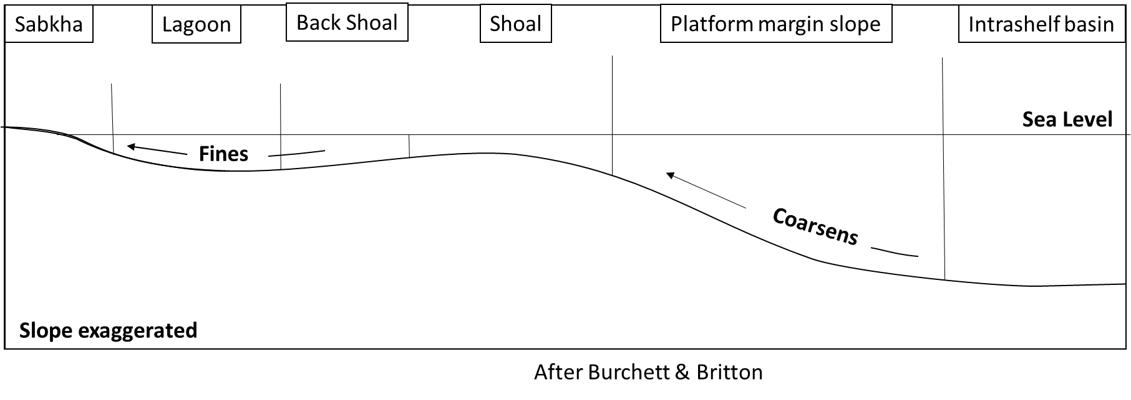
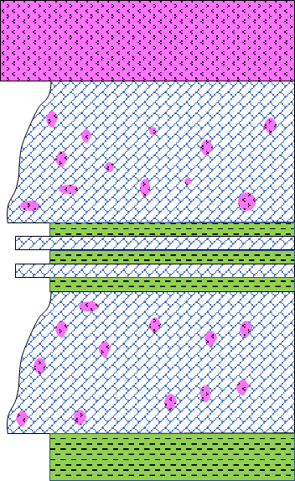
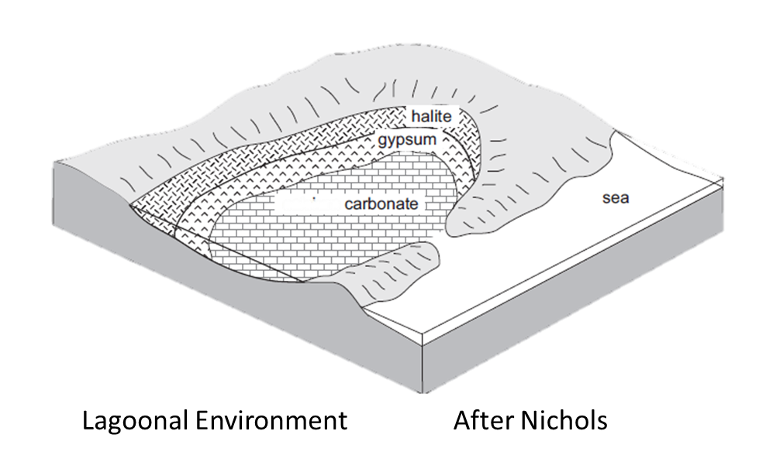
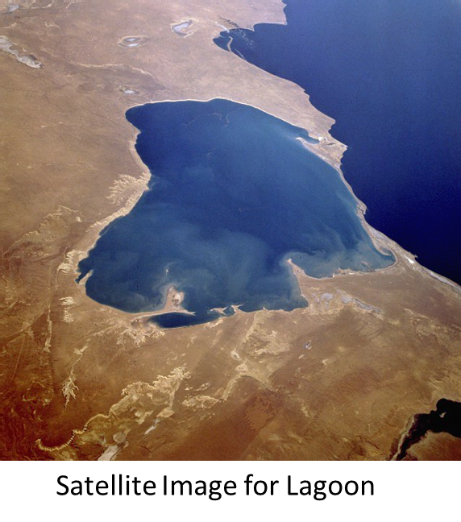
Conceptual Model

Slide 11
Reservoir Characterization
Issaran Reservoirs
Heterogeneity
Dolomitization
+ heavy Oil
Paragenesis
Diagenesis
&
mineralization
Fractures

Slide 12
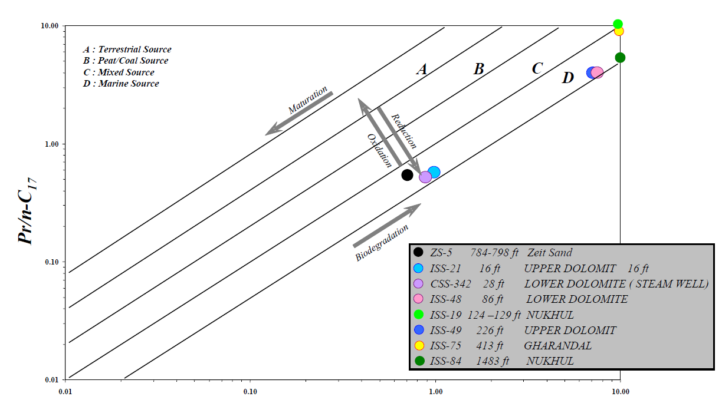
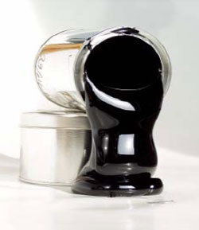
Heavy Oil
ISS Oil Field; 12° API in Shallow reservoirs.
Biodegradation and/ or Water Wash.
Heterogeneity of reservoirs.
Steam Strategy.
Drilled high density of wells.

Slide 13
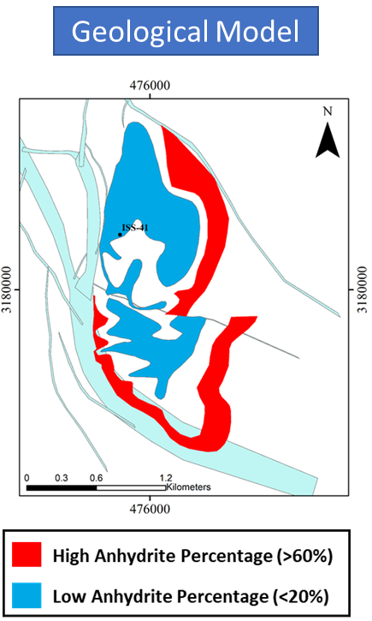
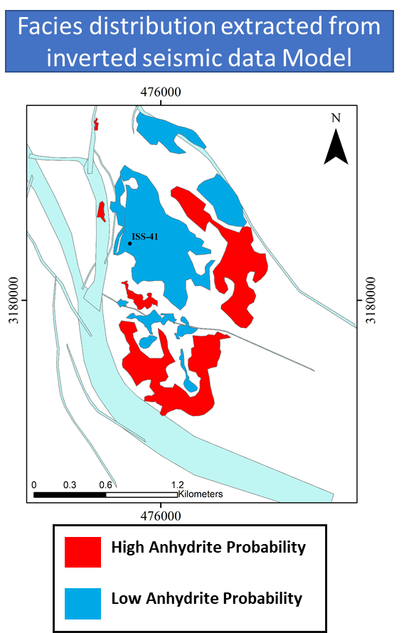
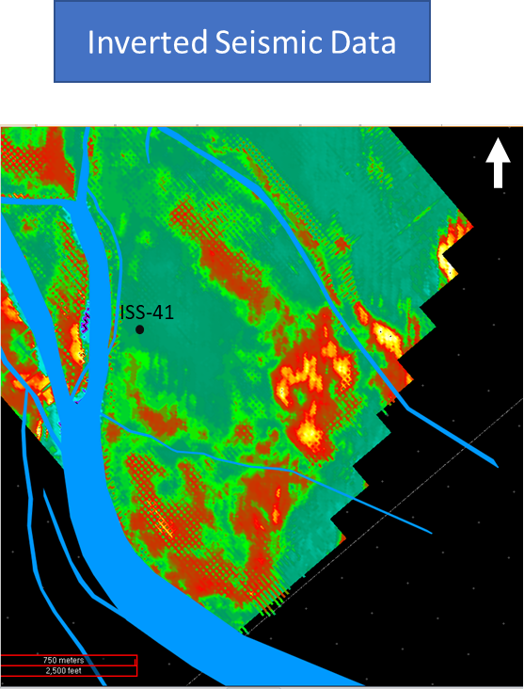
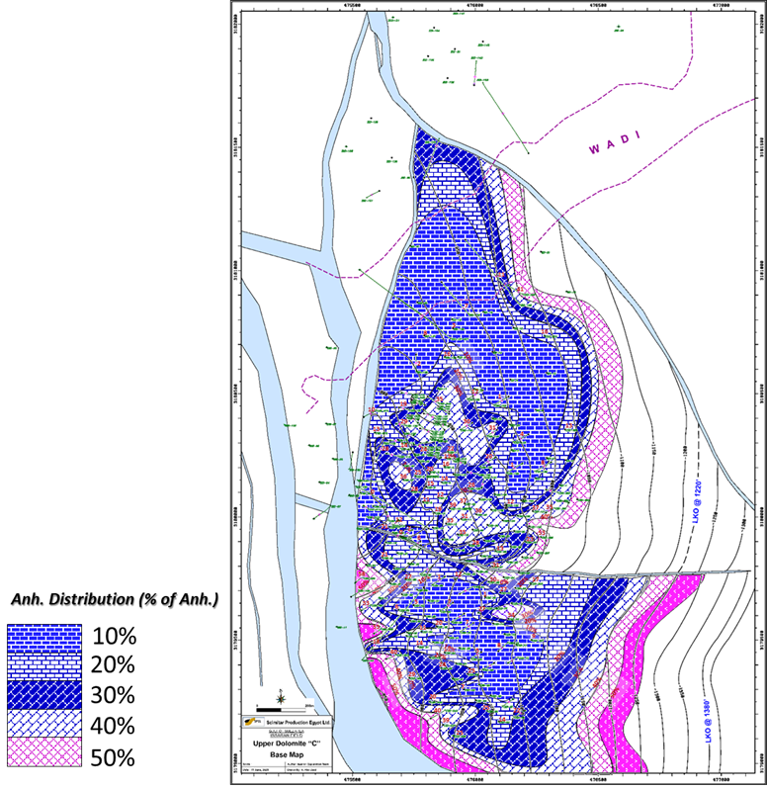
Heterogeneity
Geological Model

Slide 14
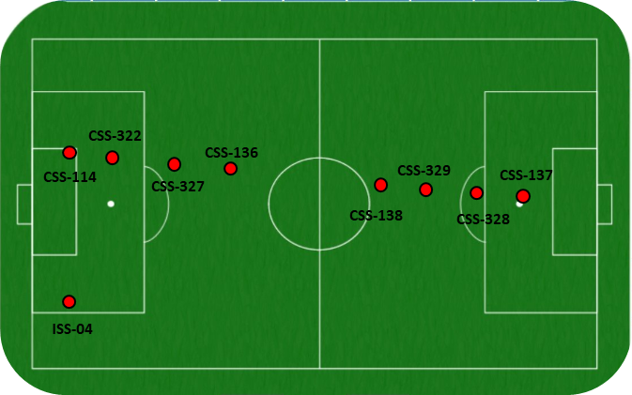
Issaran: Very high Well Density
About 9 wells
ISS-40
30 m

Slide 15
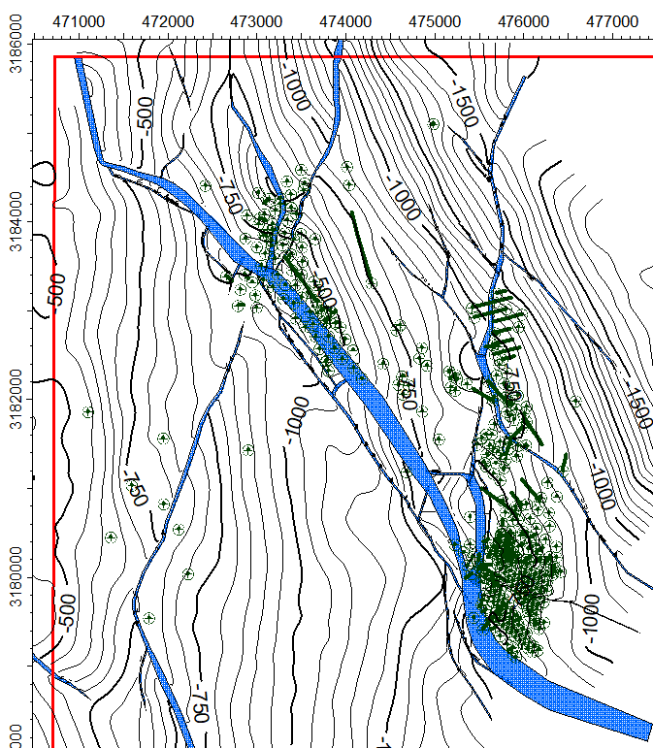
Issaran: Very high Well Density
Well Trajectory
There are high dense of wells “more than 400 wells” penetrated shallow reservoirs (-500’ : -2500’ TVDss)

Slide 16
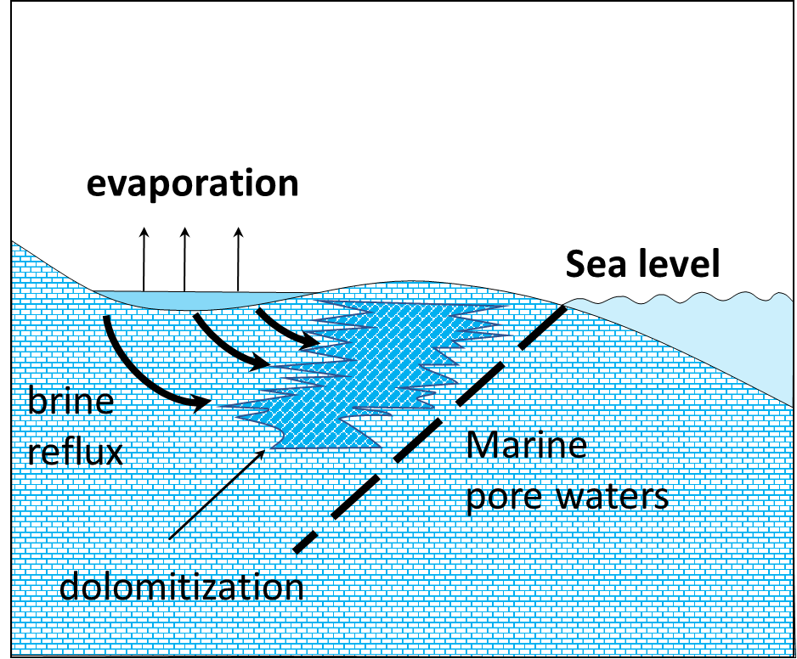
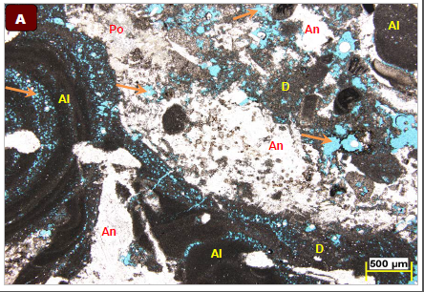
Dolomitization
Hypersaline reflux model; Dolomite is precipitated as a primary in hypersaline environments such as sabkhas and lagoons (After Boggs.2006). (Upper and Lower Dolomites)

Slide 17
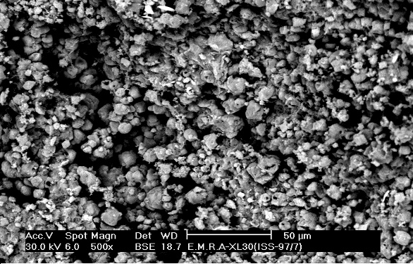
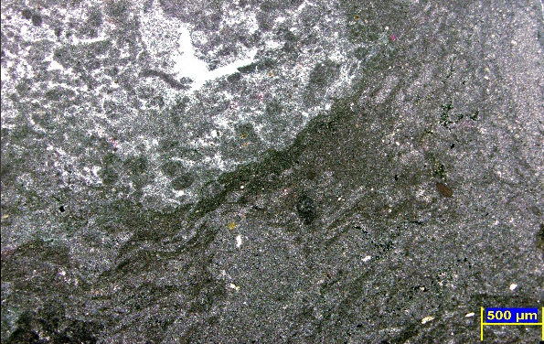
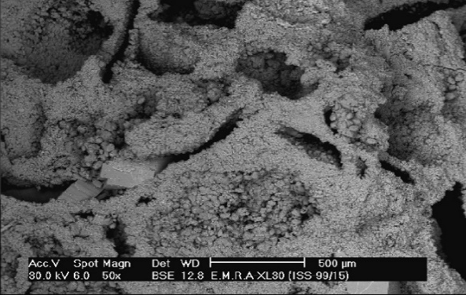
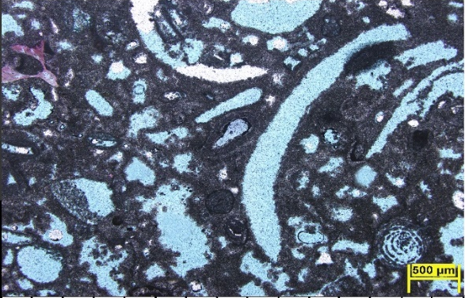
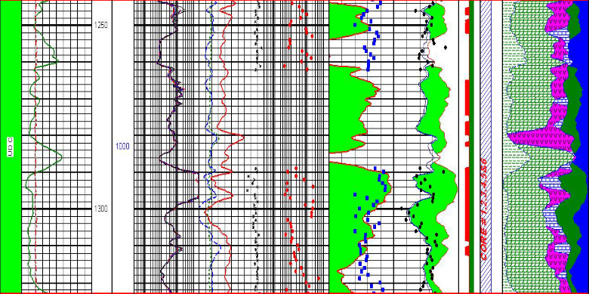
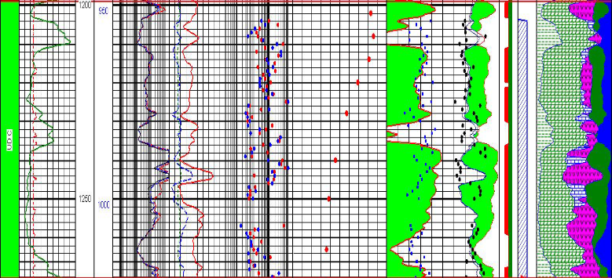
Dolomitization

Slide 18
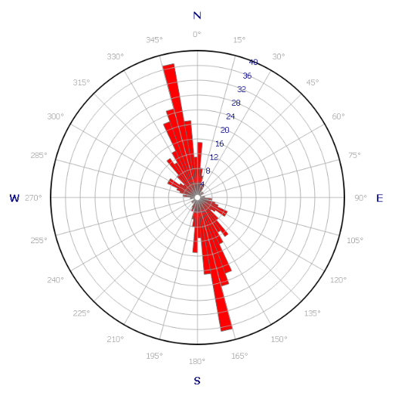
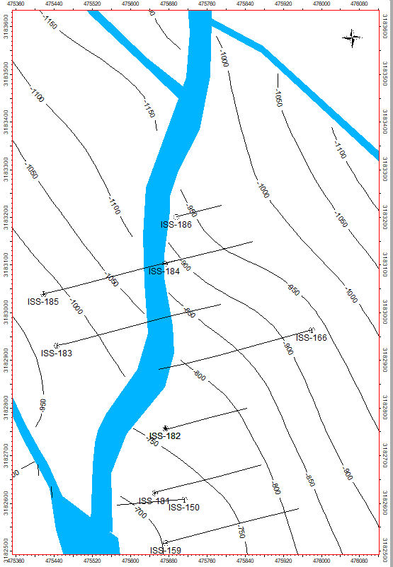
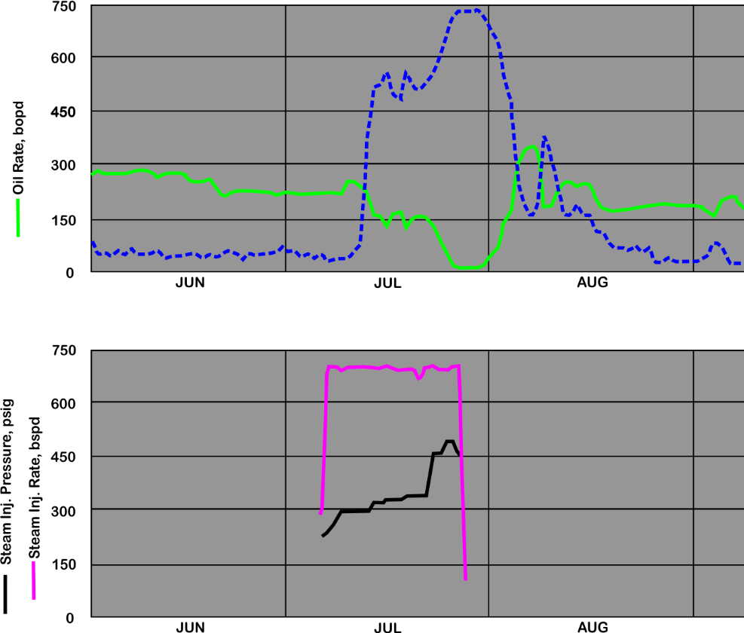
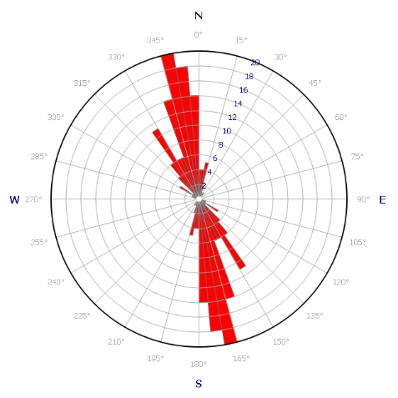
Fracturing
Water cut increase
ISS-166
ISS-183
ISS-183
ISS-166
Start Steaming

Slide 19
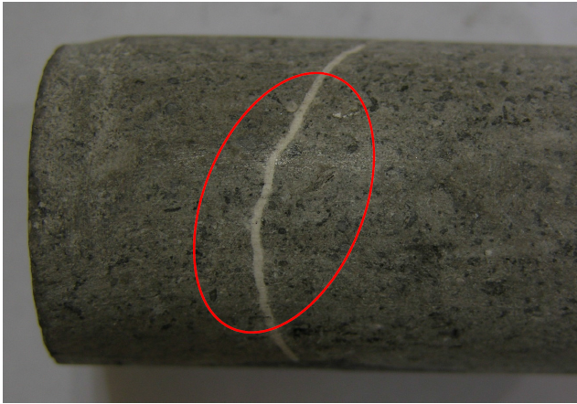
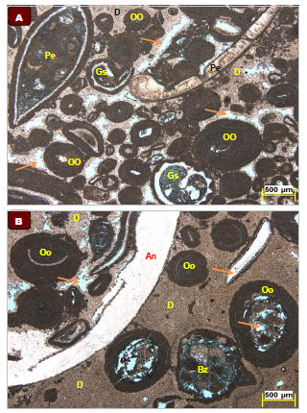
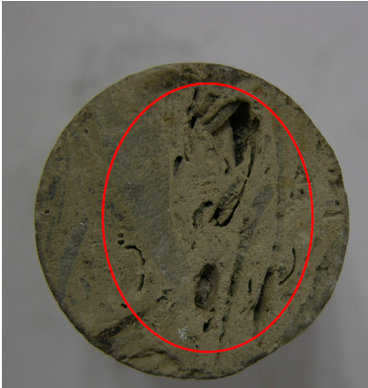
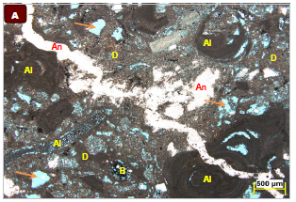
Diagenesis
&
mineralization
Fossil's replacement & Dissolution
5 cm
Fractures filled with minerals
1136’
1187’

Slide 20
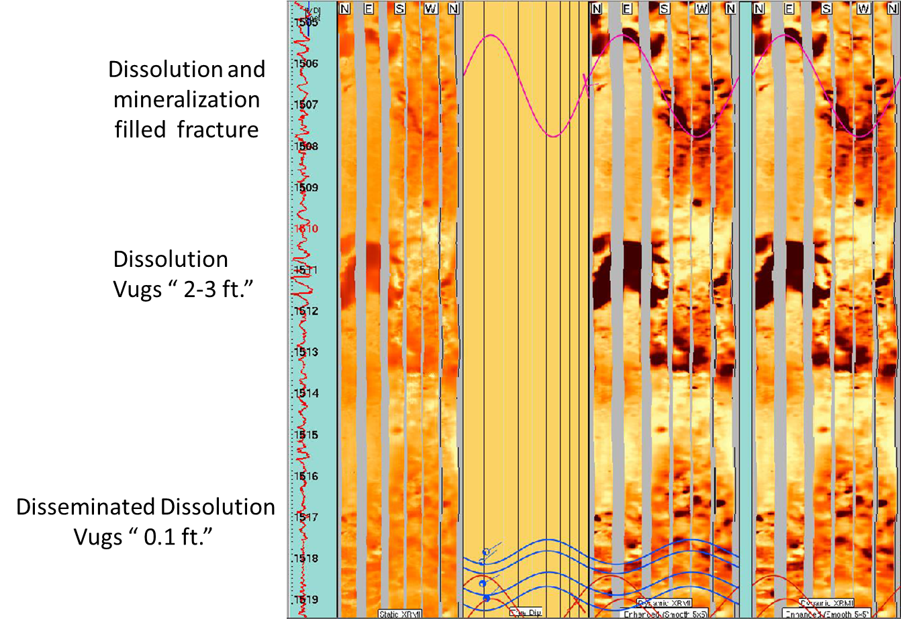
Paragenesis
4
1
Dolomitization
3
1
2
Dissolution
3
Fracturing
2
4
Cementation
5
Dissolution of Dolomite
5

Slide 21
Effect of the fracturing and dissolution on Production

Slide 22
Conclusions
Applying geological understanding to well and reservoir management in complex carbonate reservoir:
High well density allows the development of high-confidence depositional models
Depositional models can be used as predictive models for further development drilling or for steam strategy definition
Understanding the significant reservoir variability requires detailed Reservoir Characterization and understanding of diagenetic processes
  Heterogeneity.
  Dolomitization.
  Fracturing.
  Diagenesis and mineralization.
Paragenesis – understanding the reservoir requires comprehensive and continuous data acquisition
Flow Unit Identification and understanding baffles/barriers in the reservoir is needed for understanding steam movement in the reservoir

Slide 23
Thank You

